Slide 1
Loan Default

Slide 2
Problem Statement
Myhome is a company that offers housing loans with competitive rates, has faced significant losses due to loan defaults by many customers. To mitigate these losses, they seek a solution from the Data Science community to create an AI system that can predict the likelihood of loan default for future applicants, enhancing the application process and minimizing financial risks.

Slide 3
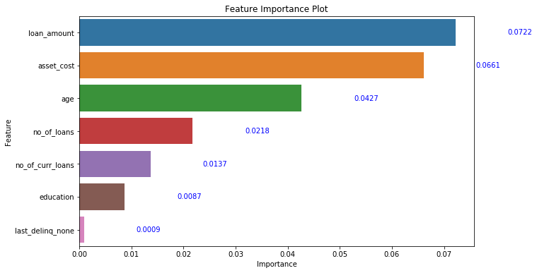
CatBoost Classifier Feature Importance

Slide 4
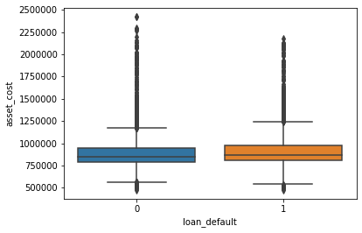
Comparison of Loan Defaults to Asset Cost

Slide 5
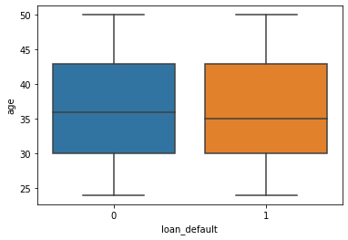
Comparison of Loan Defaults to Age

Slide 6
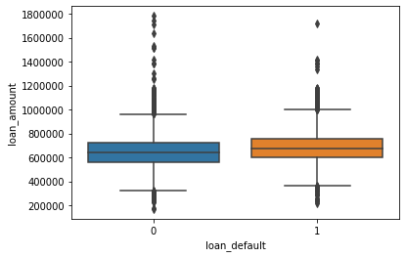
Comparison of Loan Defaults to Loan Amounts

Slide 7
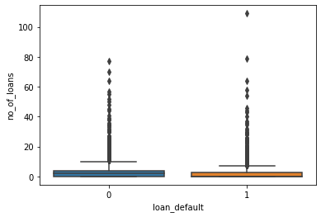
Comparison of Loan Defaults to Number of Loans

Slide 8
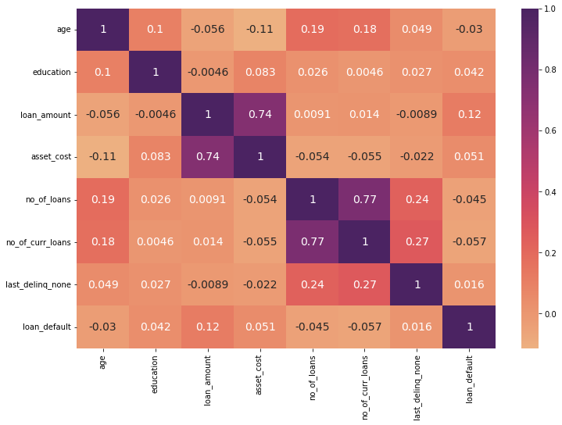
Correlation Plot

